Slide 1
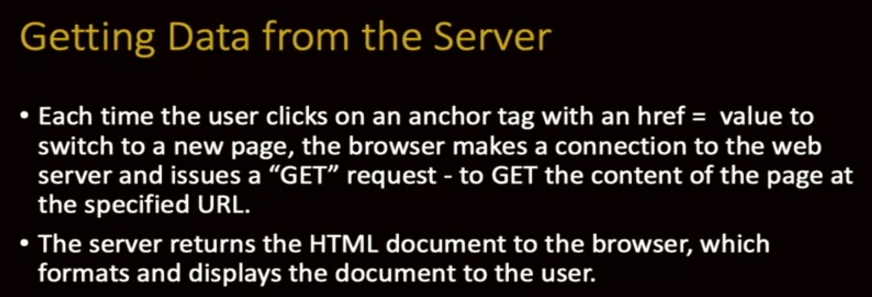
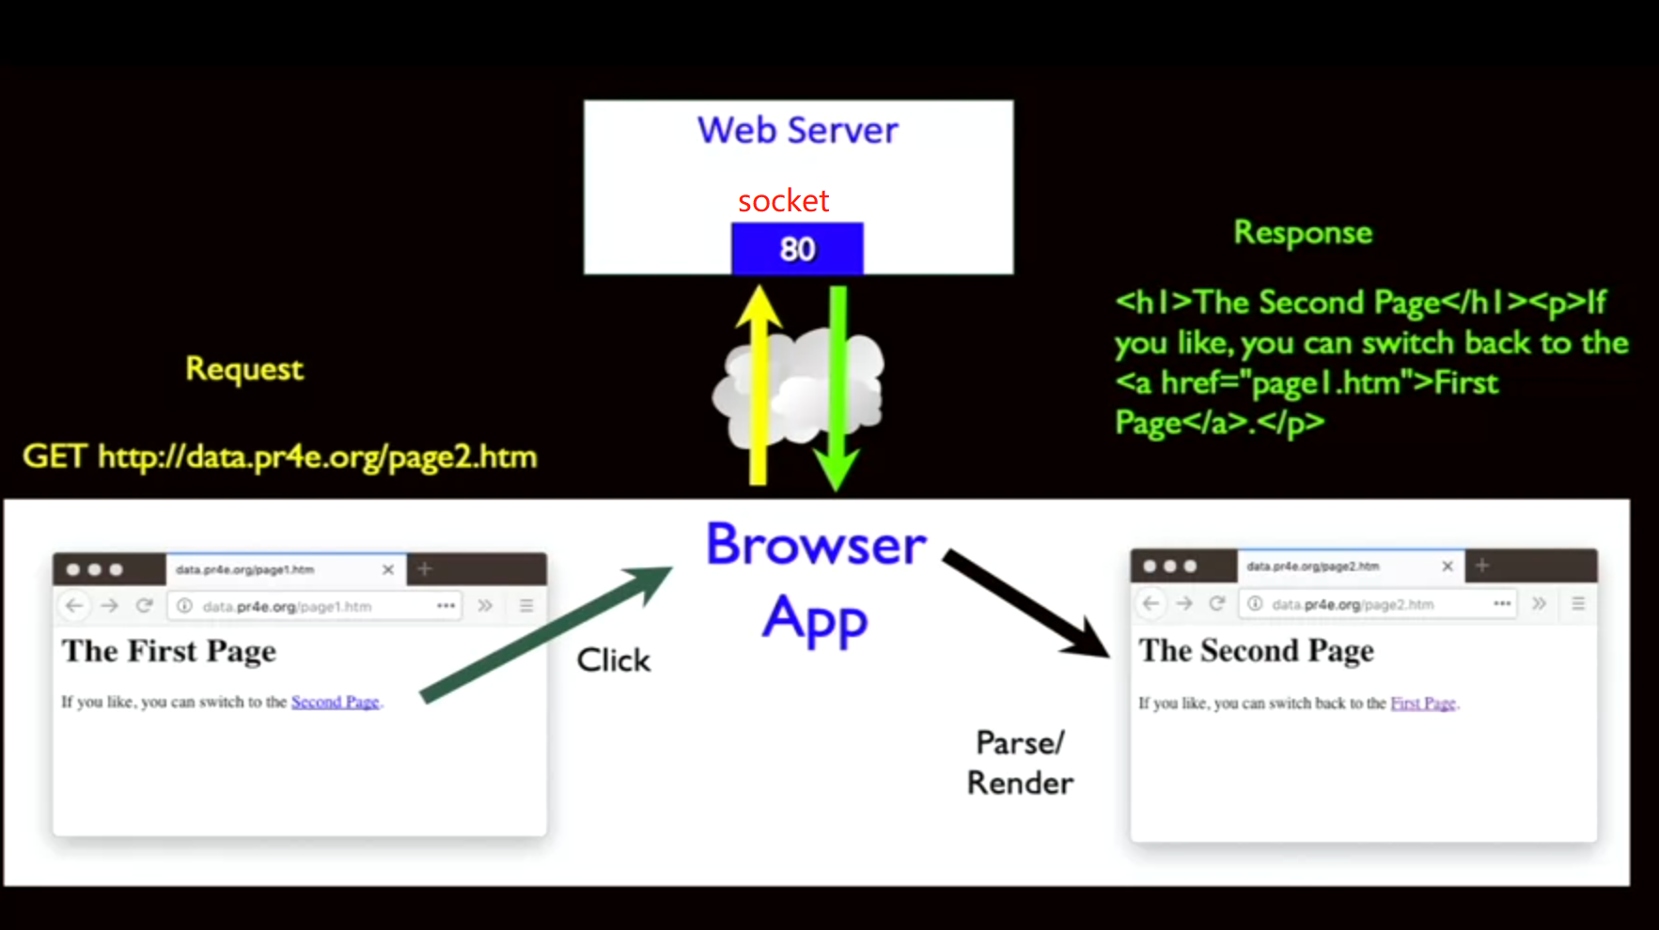
Introduction to Dynamic Web Content

Slide 2
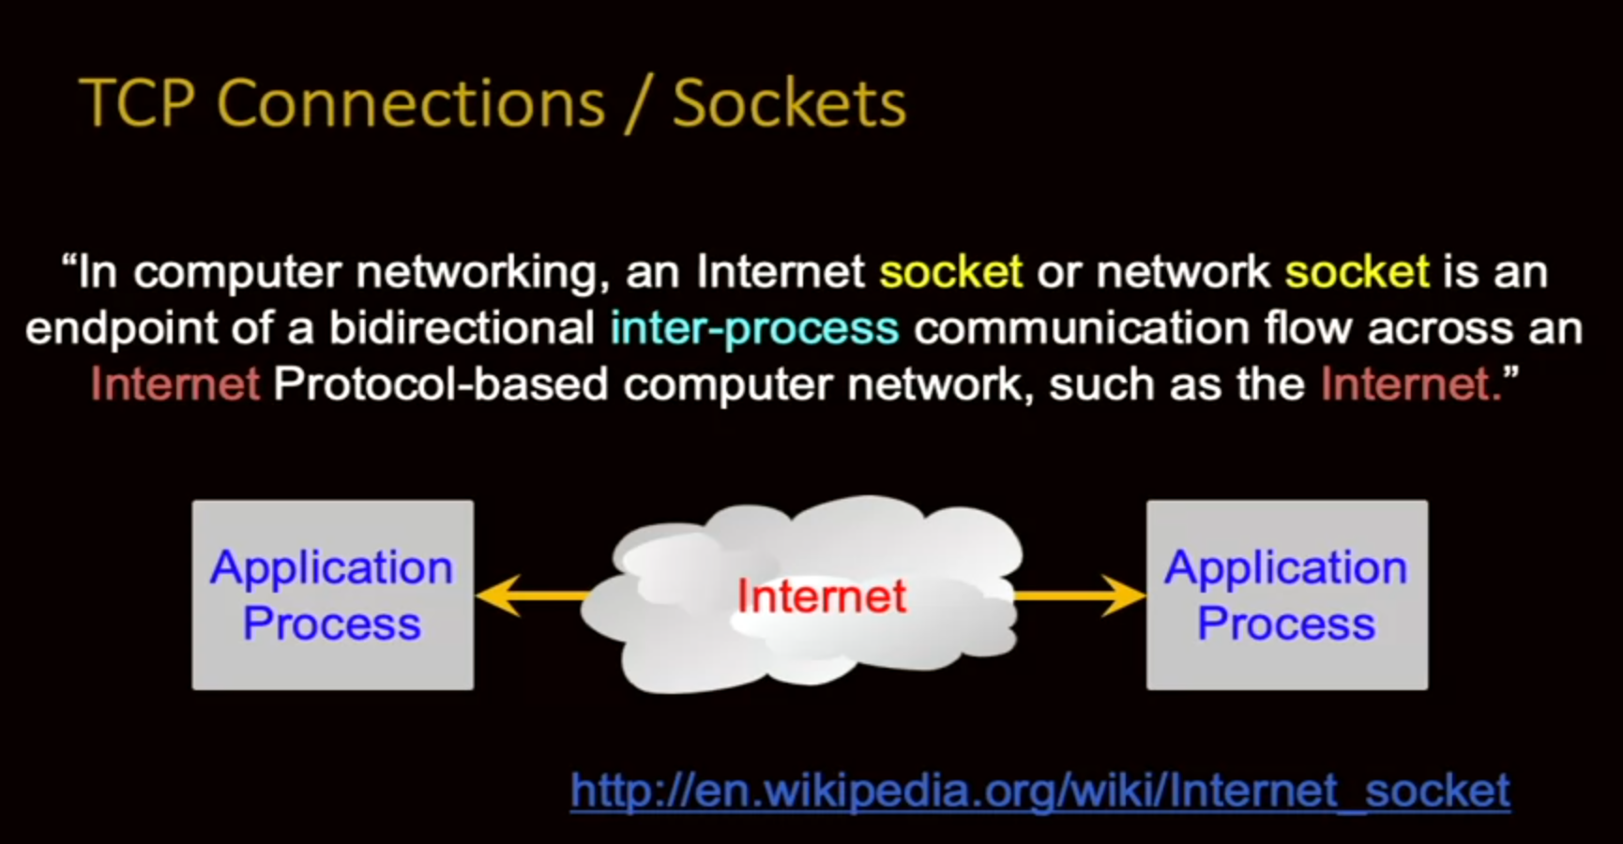
Network Sockets and Connections

Slide 3
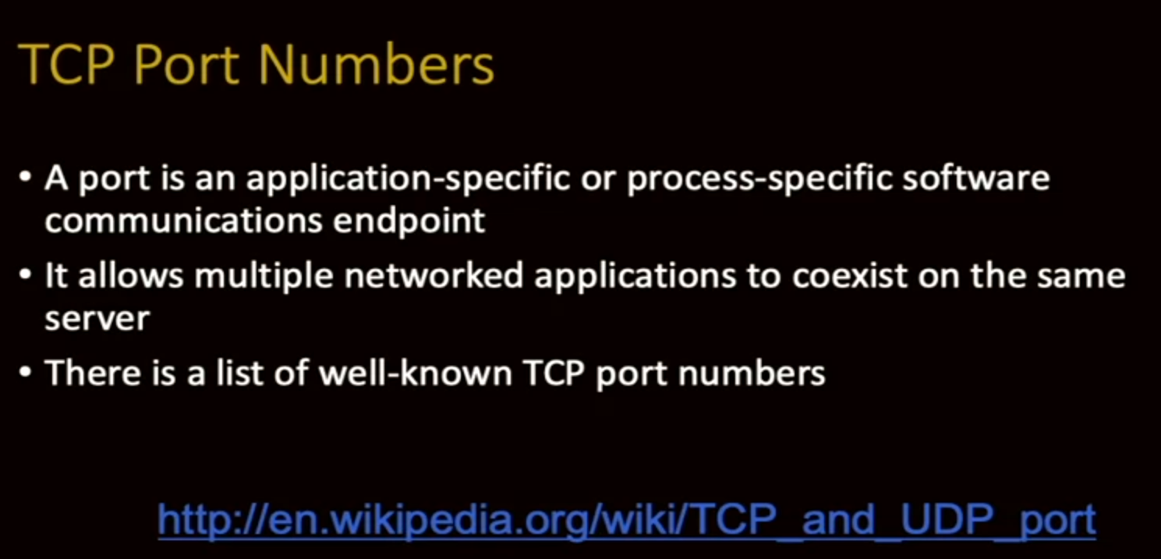
Network Sockets and Connections

Slide 4
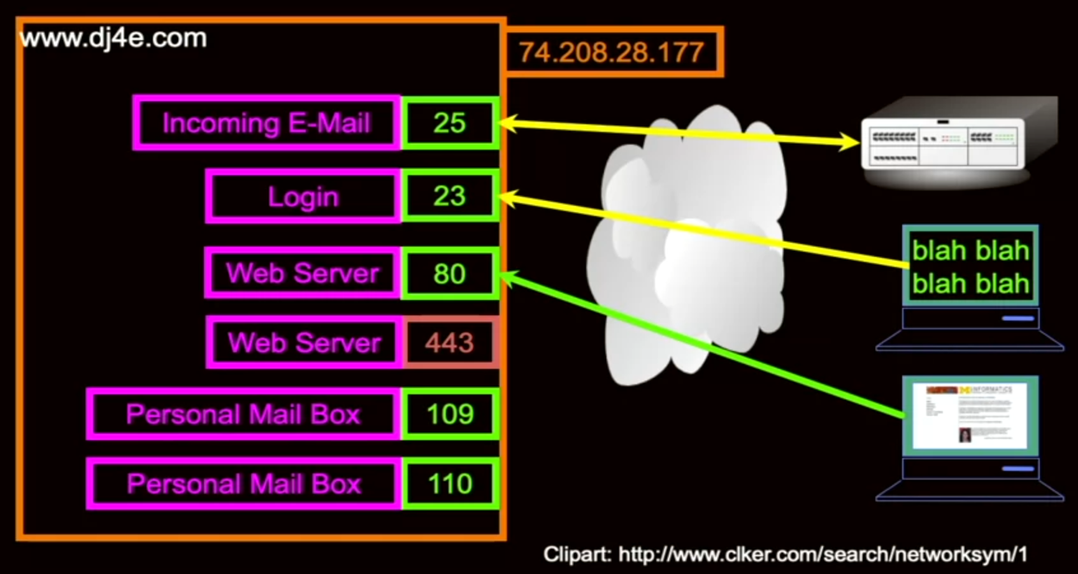
Network Sockets and Connections
Left side is server side, right side is client side. Different color of arrow represents different protocol. 443 for https, 80 for http.

Slide 5
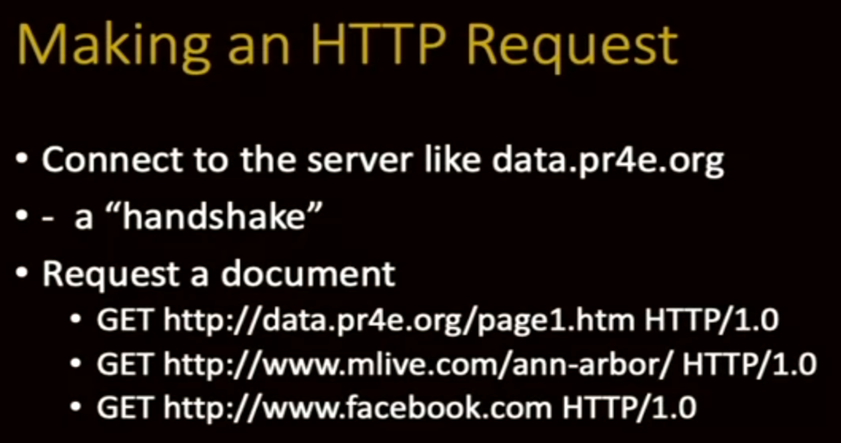
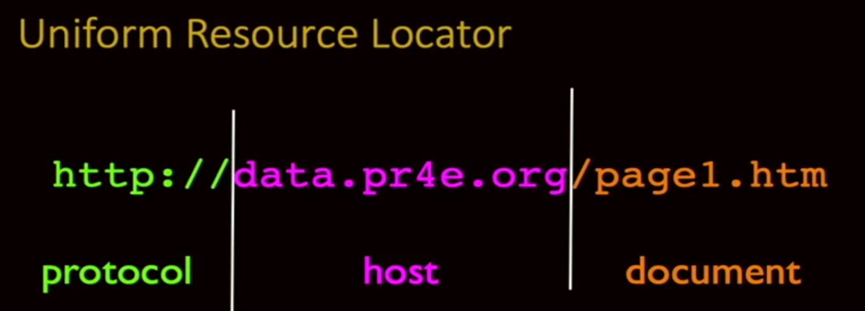
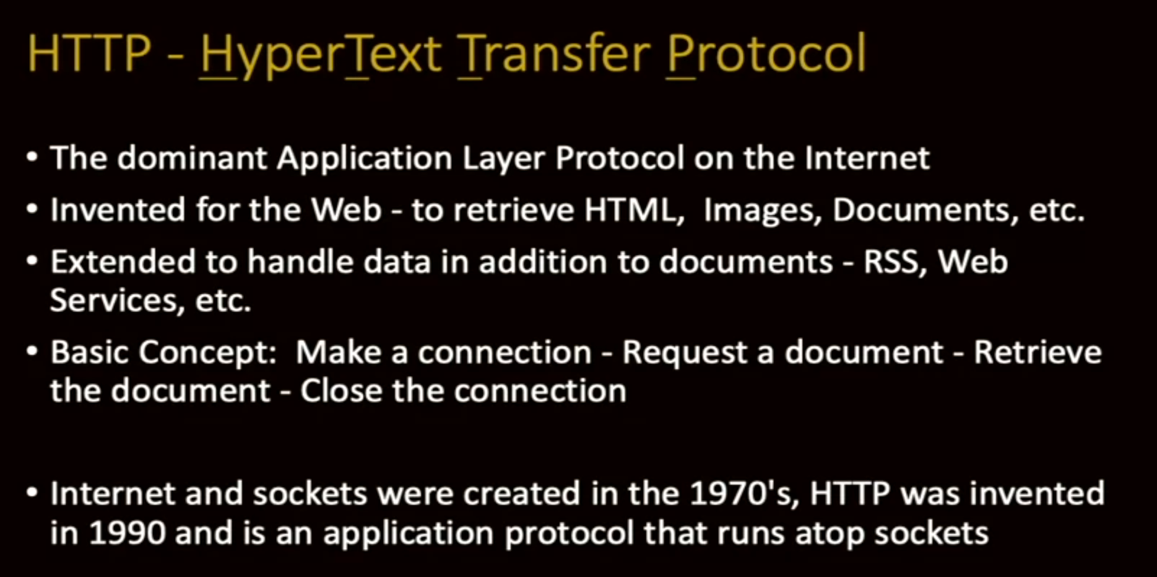
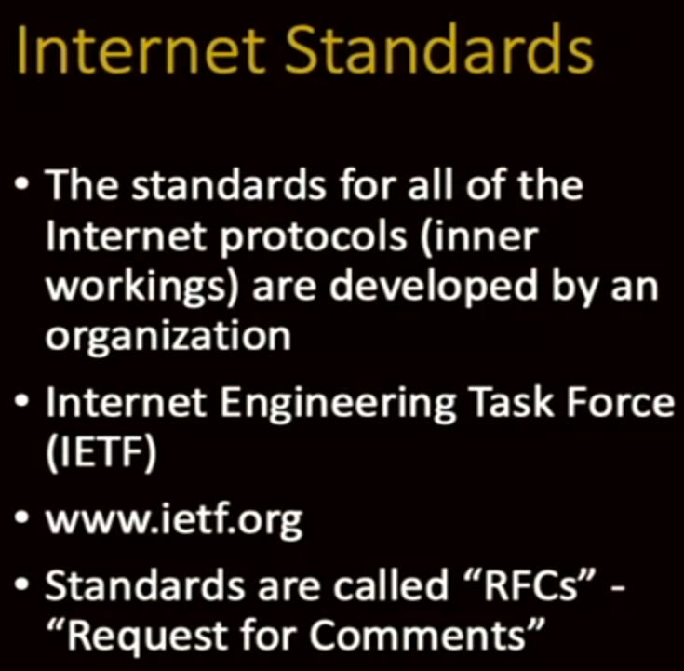
HyperText Transfer Protocol (HTTP)

Slide 6
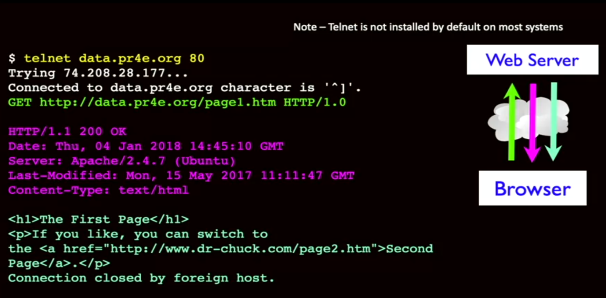
HyperText Transfer Protocol (HTTP)
Request to Server
Information from Server
Indicates the type of Document
Document from Server

Slide 7
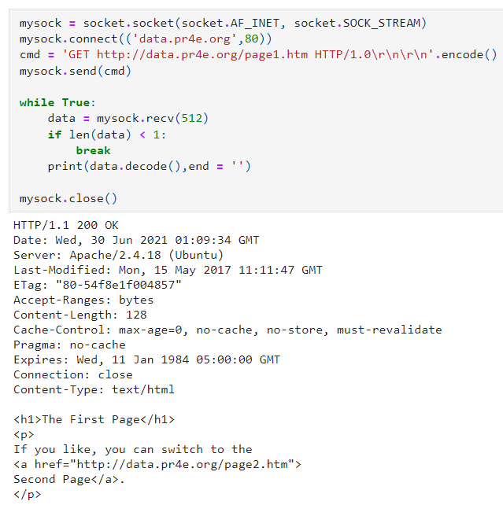
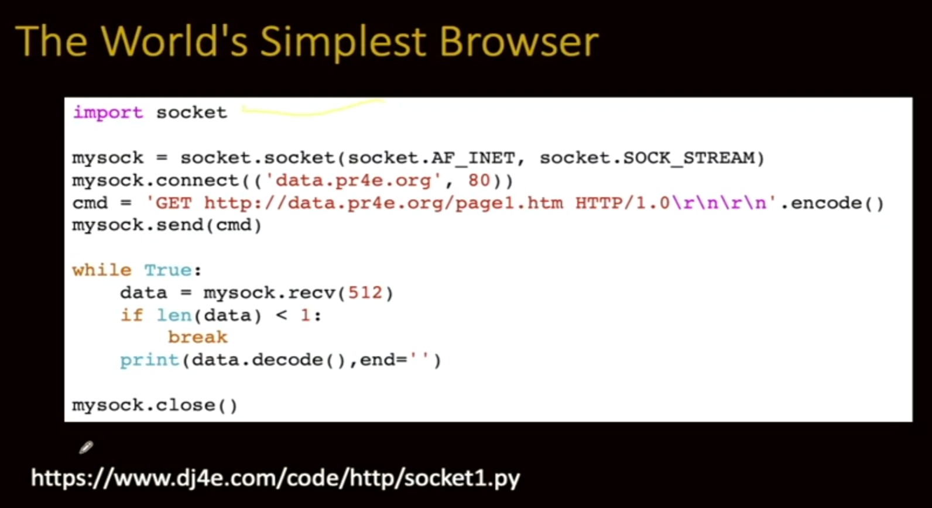
Building a Simple Web Browser in Python

Slide 8
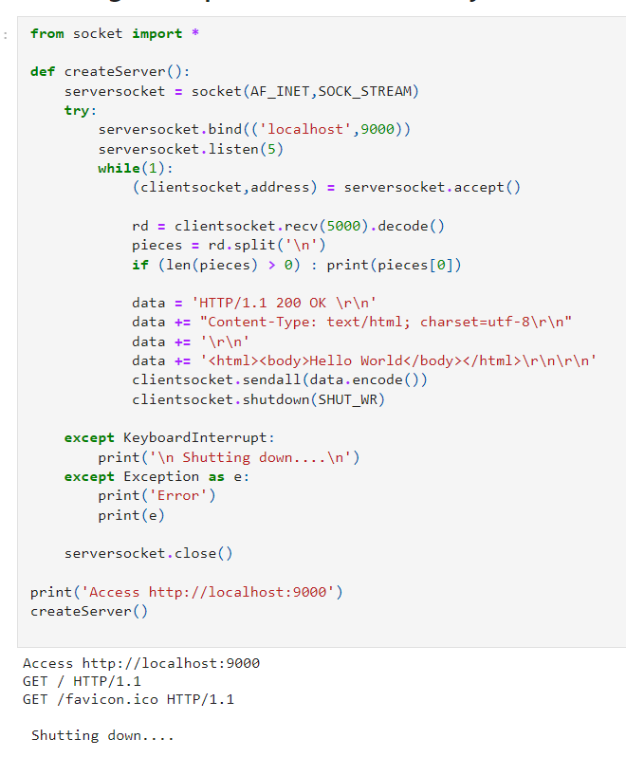
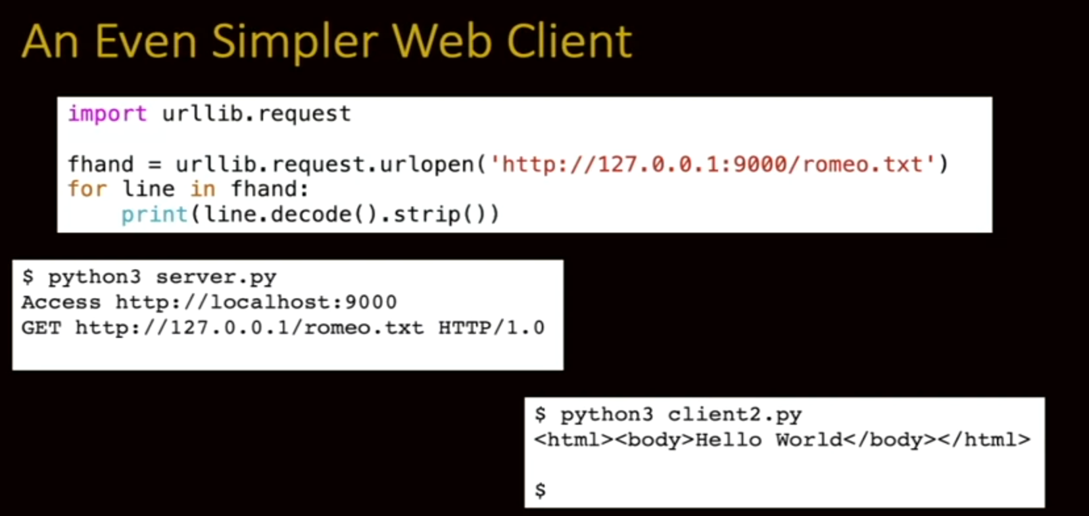
Building a Simple HTTP Server in Python
How many request can be held
The following code runs only when connection was established

Slide 9
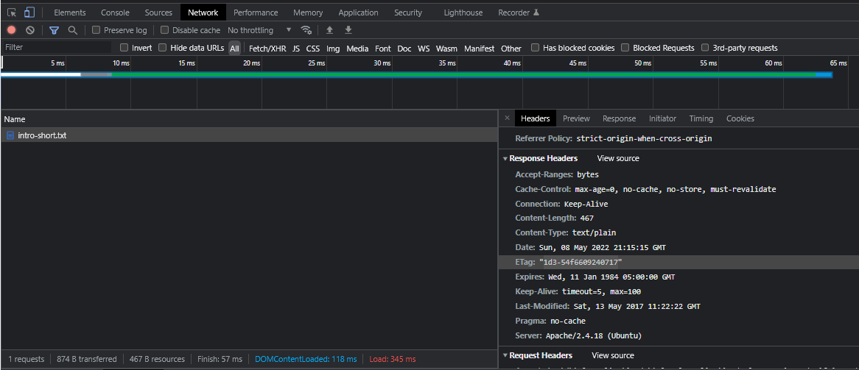
Check Header in Brower's Developer mode

